Slide 1
Nivelul Aplicaţie
DNS
Protocoale de comunicaţie - Curs 8

Slide 2
Cuprins
De ce este nevoie de DNS
Spatiul de nume DNS – structura logica arborescenta
Component DNS
Inregistrari de resurse
Serverul de nume
Protocolul DNS
Rezorvarea recursiva si iterativa a numelor
Cereri inverse
Replicarea serverelor DNS
Protocoale de comunicaţie - Curs 8

Slide 3
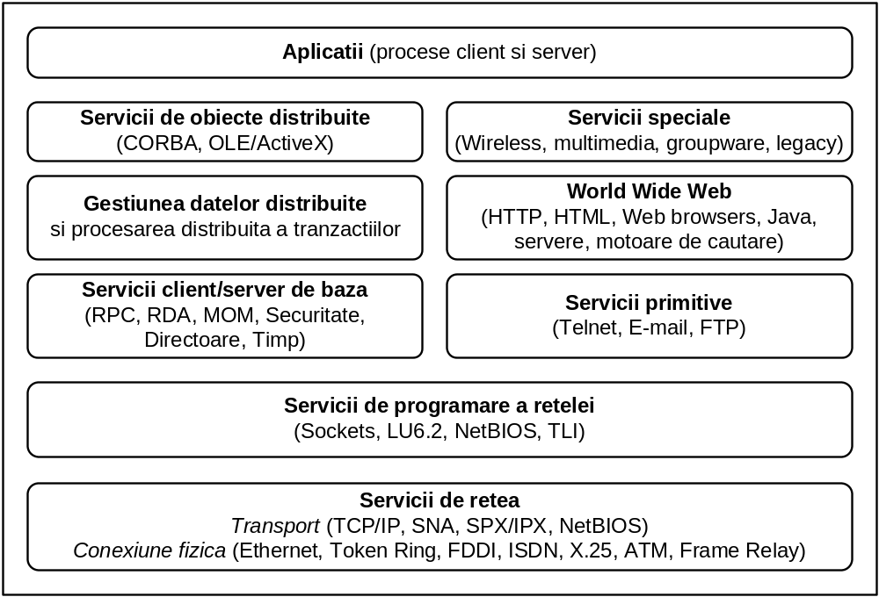
Protocoale de aplicații și Servicii Middleware
Protocoale de comunicaţie - Curs 8

Slide 4
De ce este nevoie de DNS ?
Protocoalele client – server folosesc nivelul transport (TCP, UDP) pentru schimb de mesaje
Ex.: descarcarea unei pagini Web cand utilizatorul cunoaste adresa IP si portul serverului
Browser - deschide o conexiune TCP la port 80 pe 18.23.0.23
Browser - trimite o comanda GET indicand adresa IP, portul si calea la fisierul care contine pagina TheProject.html
Serverul trimite fisierul TheProject.html
Conexiunea TCP este inchisa
Browser - afişează conţinutul din TheProject.html
Protocoale de comunicaţie - Curs 8

Slide 5
Port
Se folosesc porturi fixe pentru servicii standard
Port
Protocol
Use
21
FTP
File transfer
23
Telnet
Remote login
25
SMTP
E-mail
69
TFTP
Trivial File Transfer Protocol
79
Finger
Lookup info about a user
80
HTTP
World Wide Web
110
POP-3
Remote e-mail access
119
NNTP
USENET news
Adresele IP sunt mai greu de tinut minte !
Se folosesc adrese simbolice (nume de domeniu) a caror translatare in adrese IP este facuta de DNS
Protocoale de comunicaţie - Curs 8

Slide 6
Adrese simbolice: nume de domeniu
Continute in URL – Uniform Resource Locator
  schema protocol (http, ftp etc.)
  host ptr. web nume / adresa IP a serverului Web
  port# numar port server Web (80 pentru http)
  path calea de la radacina serverului la resursa
Schema | Utilizat pentru | Exemple
http | Hipertext (HTML) | http://www.cs.vu.nl/~ast
ftp | FTP | ftp://ftp.cs.vu.nl/pub/minix/README
mailto | Trimitere de poşta electronică | mailto:JohnUser@acm.org
telnet | Conectare la distanţă | telnet://www.w3.org:80
Protocoale de comunicaţie - Curs 8

Slide 7
Descarcarea unei pagini Web
Utilizatorul cunoaste numele simbolic al serverului si calea spre fisierul ce contine pagina
Browser - determina URL http://www.w3.org/TheProject.html
Browser - cere unui server DNS adresa IP pentru www.w3.org
  server DNS - raspunde cu 18.23.0.23
Browser - deschide o conexiune TCP la port 80 pe 18.23.0.23
Browser - trimite o comanda la server Web
    GET TheProject.html HTTP/1.1
    Host: www.w3.org
  Server Web www.w3.org trimite fisierul TheProject.html
Conexiunea TCP este inchisa
Browser - afişează conţinutul din TheProject.html
Protocoale de comunicaţie - Curs 8

Slide 8
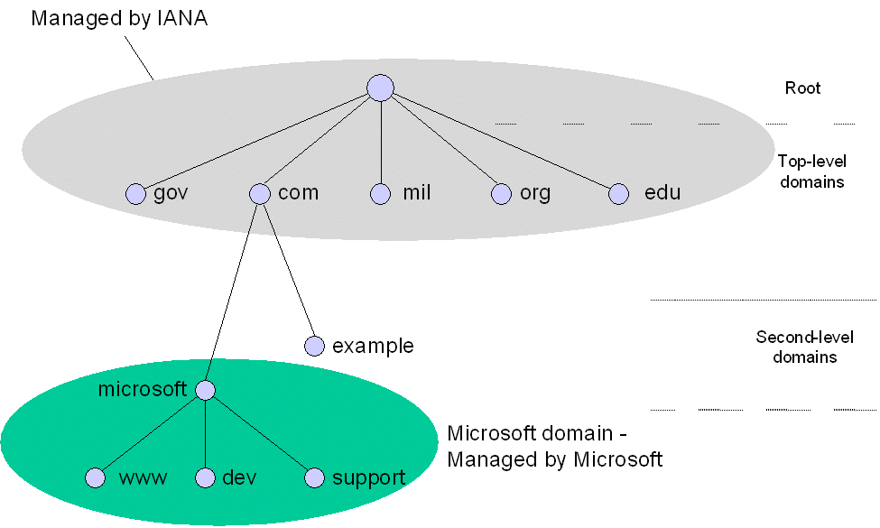
DNS – The Domain Name System
Spatiul de nume DNS – structura logica arborescenta
Fiecare nod din arbore reprezinta un domeniu
  Radacina
  De nivel inalt (gov, com,.. ) administrate de ICANN - Internet Corporation for Assigned Names and Numbers
  De nivel 2 (ex. microsoft.com) … etc.
  Frunzele corespund gazdelor
Numele unui domeniu foloseste numele nodurilor pe calea la radacina
example.com
este diferit de
example.mil
Protocoale de comunicaţie - Curs 8

Slide 9
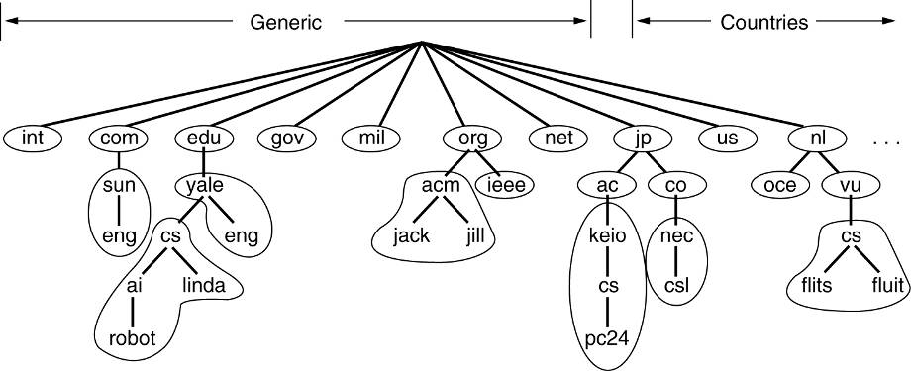
Zone DNS si Servere de Nume
Spaţiul de nume DNS este împărţit în zone administrate de servere de nume distincte (mai multe servere pot raspunde de o zona)
Serverul de nume
  pastreaza informatii pentru unul sau mai multe domenii
  cunoaste adresele altor servere (inclusiv de la nivelul inferior)
Protocoale de comunicaţie - Curs 8

Slide 10
Componente DNS
Spatiul de nume (namespace)
  organizat ierarhic
  fiecare nod are asociat un set de informatii pastrate in baze de date DNS
Servere DNS
  administreaza zone DNS
  pastreaza BD cu informatii necesare clientilor
  in inregistrari de resurse (resource records)
Protocoale de comunicaţie - Curs 8

Slide 11
Înregistrări de resurse
O BD DNS contine o colectie de Resource Records – RRs in format text
Fiecare inregistrare include:
Nume_domeniu ex: srv1.dev.microsoft.com.
    ultimul "." in srv1.dev.microsoft.com. este radacina
Timp_de_viata ex: 3600 (in secunde)
Clasa ex: IN (pentru Internet)
Tip ex: A (adresa)
Valoare ex: 157.60.221.205
Protocoale de comunicaţie - Curs 8

Slide 12
Principalele tipuri de înregistrări DNS
Tip | Semnificaţie | Valoare
SOA | Start autoritate | Start Of Authority - Parametrii pentru această zonă (ex. adresa E-mail a administratorului de sistem)
A AAAA | Adresa IP a unui sistem gazdă | Address - Întreg pe 32 de biţi (A) sau pe 128 de biti (AAAA)
MX | Server de mail | Mail eXchange – Leg. simbolica la server de mail
NS | Server de Nume | Name Server - Nume server pentru acest domeniu
CNAME | Nume canonic | Canonical Name – Legatura simbolica cu numele primar al nodului reprezentat (pseudonim)
PTR | Pointer | Pointer – uzual, numele corespunzator unei adrese IP
HINFO | Descriere sistem gazdă | Host Info – Info ptr. calculatorul reprezentat de nod (Unitate centrală, sistem operare) în format ASCII
TXT | Text | Text ASCII – orice informatie utila despre entitate
Protocoale de comunicaţie - Curs 8

Slide 13
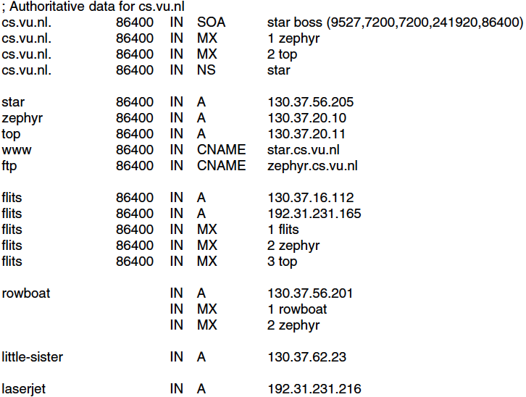
Exemplu Resource Records
O parte a unei baze de date DNS pentru cs.vu.nl
info desspre domeniu
2 servere de mail si unul de nume
3 adrese IP si 2 pseudonime pentru Web si FTP
sectiune ptr server flits cu 2 adrese si 3 servere mail
RRs statie de lucru cu 2 adrese mail
Protocoale de comunicaţie - Curs 8

Slide 14
Serverul de nume (DNS)
Local Host |
+---------+ +----------+ | +--------+
| | | |responses| | |
| | | Name |---------|->|Foreign |
| Master |------>| Server | | |Resolver|
| files | | |<--------|--| |
| | | | queries | +--------+
+---------+ +----------+ |
  Informatia primara despre zone este pastrata in fisiere master (Master files) aflate in sistemul de fisiere local serverului DNS
Un server de nume primar
  Foloseste Master files pentru a defini sau actualiza BD pentru una sau mai multe zone
  Raspunde intrebarilor resolverelor
Protocoale de comunicaţie - Curs 8

Slide 15
Translatarea de la nume domeniu la adresa IP
Local Host |
+---------+ +----------+ | +--------+
| | user queries | |queries | |Foreign |
| User |-------------->| |---------|->| |
| | user responses| Resolver |responses| | Name |
| Program |<--------------| |<--------|--| Server |
+---------+ +----------+ | +--------+
| ^ references |
+----------+ |
| cache | |
+----------+ |
Programul apeleaza un Resolver local
Formatul mesajelor user ⬄ resolver este specific sistemului gazda (apeluri SO). Ex. - UNIX gethostbyname
Resolver apeleaza un server DNS local (ii cunoaste adresa IP!)
Format mesaje resolver ⬄ name server este standard (protocol DNS)
Resolver poate pastra in cache numele si adresele IP recent rezolvate
Perioada cache este data de time-to-live din Resource Record
Protocoale de comunicaţie - Curs 8

Slide 16
Protocolul DNS
Software de rezolvare disponibil ca proceduri de biblioteca
  Exemplu - UNIX gethostbyname
La apelul unui client, Resolverul
  Construieşte un mesaj DNS request
  Transmite mesajul serverului DNS local
Serverul DNS rezolva numele
  Construieşte un mesaj DNS reply
  Trimite mesajul Resolverului si aşteaptă următoarea cerere
Protocoale de comunicaţie - Curs 8

Slide 17
Format mesaje DNS
+---------------------+
| Header |
+---------------------+
| Question | the question for the name server
+---------------------+
| Answer | RRs answering the question
+---------------------+
| Authority | RRs pointing toward an authority
+---------------------+
| Additional | RRs holding additional information
+------------------------+
RR = Resource Record
Header contine info despre
  ce sectiuni sunt prezente in mesaj
  mesajul este intrebare sau raspuns
  sau alta operatie (se specifica cod operatie)
Protocoale de comunicaţie - Curs 8
Notes:
All communications inside of the domain protocol are carried in a single
format called a message. The top level format of message is divided
into 5 sections (some of which are empty in certain cases) shown below:
+---------------------+
| Header |
+---------------------+
| Question | the question for the name server
+---------------------+
| Answer | RRs answering the question
+---------------------+
| Authority | RRs pointing toward an authority
+---------------------+
| Additional | RRs holding additional information
+---------------------+
The header section is always present. The header includes fields that
specify which of the remaining sections are present, and also specify
whether the message is a query or a response, a standard query or some
other opcode, etc.
The names of the sections after the header are derived from their use in
standard queries. The question section contains fields that describe a
question to a name server. These fields are a query type (QTYPE), a
query class (QCLASS), and a query domain name (QNAME). The last three
sections have the same format: a possibly empty list of concatenated
resource records (RRs). The answer section contains RRs that answer the
question; the authority section contains RRs that point toward an
authoritative name server; the additional records section contains RRs
which relate to the query, but are not strictly answers for the
question.

Slide 18
Format mesaje DNS (2)
+---------------------+
| Header |
+---------------------+
| Question | the question for the name server
+---------------------+
| Answer | RRs answering the question
+---------------------+
| Authority | RRs pointing toward an authority
+---------------------+
| Additional | RRs holding additional information
+------------------------+
Question – intrebarea
  tuplu Nume-domeniu, tip, clasa
  este singurul camp inclus in intrebare
Answer include RRs care corespund intrebarii
Restul – colectie de RRs reprezentand raspunsul, autoritatea si info aditionale
Protocoale de comunicaţie - Curs 8
Notes:
All communications inside of the domain protocol are carried in a single
format called a message. The top level format of message is divided
into 5 sections (some of which are empty in certain cases) shown below:
+---------------------+
| Header |
+---------------------+
| Question | the question for the name server
+---------------------+
| Answer | RRs answering the question
+---------------------+
| Authority | RRs pointing toward an authority
+---------------------+
| Additional | RRs holding additional information
+---------------------+
The header section is always present. The header includes fields that
specify which of the remaining sections are present, and also specify
whether the message is a query or a response, a standard query or some
other opcode, etc.
The names of the sections after the header are derived from their use in
standard queries. The question section contains fields that describe a
question to a name server. These fields are a query type (QTYPE), a
query class (QCLASS), and a query domain name (QNAME). The last three
sections have the same format: a possibly empty list of concatenated
resource records (RRs). The answer section contains RRs that answer the
question; the authority section contains RRs that point toward an
authoritative name server; the additional records section contains RRs
which relate to the query, but are not strictly answers for the
question.

Slide 19
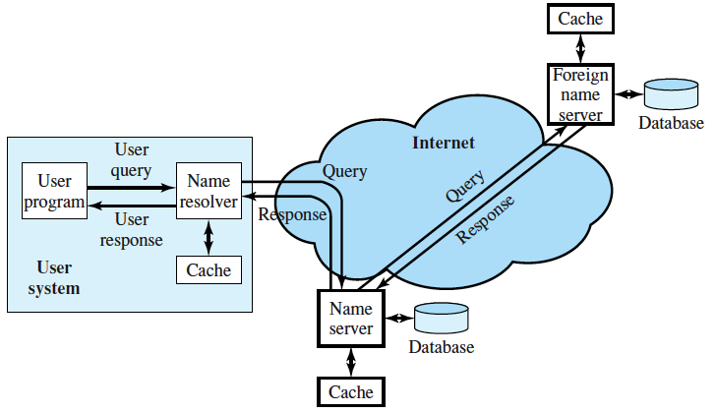
Un server DNS este server autoritate ptr numele gestionate
Daca cererea conţine un nume gestionat de serverul apelat, acesta răspunde direct
Altfel, cererea trebuie sa ajunga la serverul autoritate pentru acel nume
Protocoale de comunicaţie - Curs 8

Slide 20
O posibila ierarhie de servere DNS
Server de nume
Root
Server de nume
nl
Server de nume
com
Server de nume
vu
Server de nume
intel
Server de nume
cs
Server de nume
ee
adresele ptr nume de top (nl, com) sunt stiute de root
exista mai multe servere root, adresele lor IP fiind copiate, din fisiere de config in cache DNS, la pornirea serverului DNS
Protocoale de comunicaţie - Curs 8

Slide 21
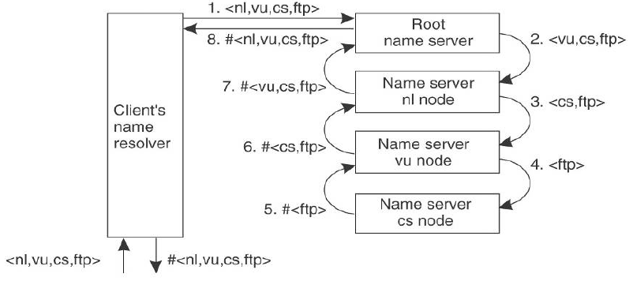
Rezolvare recursivă
cererea este pasata de la un server DNS la altul pana ajunge la serverul DNS care rezolva numele din cerere
raspunsul este trimis pe calea inversa
In exemplu: #<ftp> este adresa IP a serverului ftp.cs.vu.nl
Protocoale de comunicaţie - Curs 8
Notes:
Somewhat ironically, the second phase (the actual mapping of the name into an address) is fairly simple. It is the first phase—finding the right server—that is potentially difficult, and comprises most of the work in DNS name resolution. While perhaps surprising, this is a predictable result of how DNS is structured. Name information in DNS is not centralized, but rather distributed throughout a hierarchy of servers, each of which is responsible for one zone in the DNS name space. This means we have to follow a special sequence of steps to let us find the server that has the information we need.
The formal process of name resolution parallels the tree-like hierarchy of the DNS name space, authorities and servers. Resolution of a particular DNS name starts with the most general part of the name, and proceeds from it to the most specific part. Naturally, the most general part of every name is the root of the DNS tree, represented in a name as a trailing “dot”, sometimes omitted. The next most-specific part is the top-level domain, then the second-level domain and so forth. The DNS name servers are “linked” in that the DNS server at one level knows the name of the servers that are responsible for subdomains in zones below it at the next level.
Suppose we start with the fully-qualified domain name (FQDN) “C.B.A.”. Formally, every name resolution begins with the root of the tree—this is why the root name servers are so important. It's possible that the root name servers are authoritative for this name, but probably not; that's not what the root name servers are usually used for. What the root name server does know is the name of the server responsible for the top-level domain, “A.”.
The name server for “A.” in turn may have the information to resolve “C.B.A.” It's still fairly high-level, though, so “C.B.A” is probably not directly within its zone. In that case, it will not know the address we seek, but it will know the name of the server responsible for “B.A.”. In turn, that name server may be authoritative for “C.B.A.”, or it may just know the address of the server for “C.B.A.”, which will have the information we need. As you can see, it is very possible that several different servers may be needed in a name resolution.

Slide 22
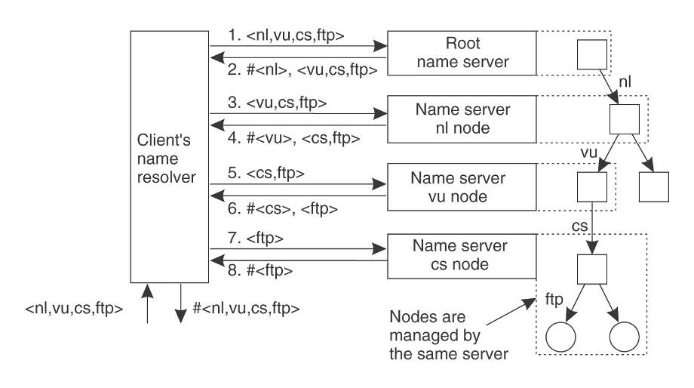
Rezolvare Iterativă
daca serverul DNS nu poate rezolva intregul nume, el trimite clientului partea nerezolvata si adresa serverului DNS care o poate rezolva
clientul trimite o noua cerere acestui server DNS
Protocoale de comunicaţie - Curs 8

Slide 23
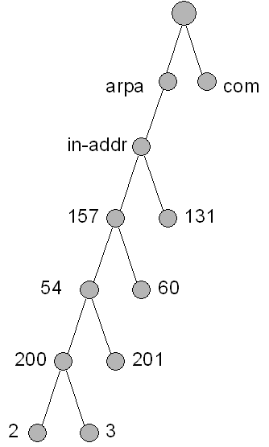
Cereri inverse
Cauta nume pentru adresa IP 157.54.200.2
Organizare - un domeniu special in-addr.arpa in care nodurile sunt numite dupa numerele din adresa IP
In in-addr.arpa se creaza inregistrari PTR, in care numele sunt adrese IP
Clientul face o cerere PTR pentru numele 2.200.54.157.in-addr.arpa
Cautarea se face in inregistrari PTR si intoarce numele resursei care corespunde adresei IP 157.54.200.2, de ex. mail.alfa.com.
Aplicatie: in tracert – pentru afisare nume rutere
Protocoale de comunicaţie - Curs 8
Notes:
If most people had to boil down the core job of the Domain Name System to one function, they would probably say it was converting the names of objects into the numeric IP addresses associated with them. Well, they would if they knew much about DNS. For this reason, DNS is sometimes compared to a telephone book, or to telephone “411” service. There are certain problems with this analogy, but at the highest level it is valid. In both cases we take a name, consult a database (of one type or another), and produce from it a number that matches that name.
The Need for Reverse Name Resolution In the real world, there are sometimes situations where you don't want to find the phone number that goes with a name, but rather, you have a phone number and want to know what person it belongs to. For example, this might happen if your telephone records the number of incoming calls but you don't have Caller ID to display the name associated with a number. You might also find a phone number on a piece of paper and not remember whose number it is.
Similarly, in the networking world, there are many situations where we have an IP address and want to know what name goes with it. For example, a World Wide Web server records the IP address of each device that connects to it in its server logs, but these numbers are generally meaningless to humans, who prefer to see the names that go with them.
A more serious example might be a hacker trying to break into your computer; by converting the IP address into a name you might be able to find out what part of the world he is from, what ISP he is using, and so forth. There are also many reasons why a network administrator might want to find out the name that goes with an address, for setup or troubleshooting purposes.
The Original Method: Inverse Querying DNS originally included a feature called inverse querying that would allow this type of “opposite” resolution. A resolver could send a query which, instead of having a name filled in and a space for the server to fill in the IP address, had the IP address and a space for the name. The server would check its resource records and return the name to the resolver.
This works fine in theory, and even in practice if the internetwork is very small. However, remember that due to the distributed nature of DNS information, the biggest part of the job of resolution is in fact finding the right server. Now, in the case of regular resolution, we can easily find the right server by traversing the hierarchy of servers. This is possible because the servers are connected together following a hierarchy of names.
DNS servers are not, however, arranged based on IP address. This means that to use inverse queries, we have to use the right name server for the IP address we want to resolve into a name, with no easy way to find out what it is. Sure, we could try sending the inverse query to the authoritative DNS server for every zone in the hierarchy. If you tried, it would probably take you longer than it took to write this Guide. So let's not go there. The end result of all of this is that inverse queries were never popular except for local server troubleshooting. They were formally removed from DNS in November 2002 through the publishing of RFC 3425
The IN-ADDR.ARPA Name Structure for Reverse Resolution
The problem here is that the servers are arranged by name and not be IP address. The solution, therefore, is as simple as it sounds: arrange the servers by IP address. This doesn't mean we remove the name hierarchy, or duplicate all the servers, or anything silly like that. Instead, we create an additional, numerical hierarchy that coexists with the name hierarchy. We then use this to find names from numbers, using a process commonly called reverse name resolution.
The name hierarchy for the Internet is implemented using a special domain called “IN-ADDR.ARPA”, located within the reserved “.ARPA” top-level domain (“IN-ADDR” stands for “INternet ADDRess”. Recall that “.ARPA” was originally used to transition old Internet hosts to DNS, and is now used by the folks that run the Internet for various purposes.
A special numerical hierarchy is created within “IN-ADDR.ARPA” that covers the entire IP address space:
At the first level within “IN-ADDR.ARPA” there are 256 subdomains called “0”, “1”, “2” and so on, up to “255”. For example, “191.IN-ADDR.ARPA”. (Actually there may not be all 256 of these since some IP addresses are reserved, but let's ignore that for now).
Within each of the subdomains above, there are 256 further subdomains at the second level, numbered the same way. So for example, one of these would be “27.191.IN-ADDR.ARPA”.
Again, there are 256 subdomains at the third level within each of the above, such as “203.27.191.IN-ADDR.ARPA”
Finally, there are 256 subdomains at the fourth level within each of the third-level subdomains, such as “8.203.27.191.IN-ADDR.ARPA”.
This structure is illustrated in Figure 246. As you can see, within “IN-ADDR.ARPA” we have created a name space that parallels the address space of the Internet Protocol. (Yes, this means there are several billion nodes and branches in this part of the Internet DNS name space!)

Slide 24
Replicarea serverelor DNS
Fiecare zona trebuie sa aiba mai multe servere DNS
Server Primar – pe el se fac toate modificarile inregistrarilor, folosind Master files
Secundar – preia info de la servere primare
  pentru asta, foloseste acelasi format de mesaje DNS
Local Host Foreign
+----------+ | +--------+
+---------+ | |responses| | |
| | | Name |---------|->|Foreign |
| Master |------>| Server | queries | |Resolver|
| files | | |<--------|--| |
| | +----------+ | +--------+
+---------+ ^ |maintenance | +--------+
| +-------------|->|Foreign |
| queries | | Name |
+-------------------|--| Server |
maintenance responses | +--------+
Protocoale de comunicaţie - Curs 8
Notes:
In this configuration, the name server periodically establishes a
virtual circuit to a foreign name server to acquire a copy of a zone or
to check that an existing copy has not changed. The messages sent for
these maintenance activities follow the same form as queries and
responses, but the message sequences are somewhat different.

Slide 25
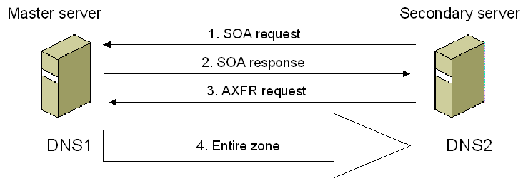
Facilitati – transfer toata zona
Server secundar
  (periodic) Cerere SOA (Start Of Authority)
  Primeste raspuns si verifica daca "serial number" este mai mare decat cel local
  Daca da, cere toata zona (cerere AXFR – Authoritative transfer)
  Primeste info toata zona
Protocoale de comunicaţie - Curs 8
Notes:
1.The secondary server waits until the next refresh time (as specified in the SOA resource record) and then queries the master server for the SOA resource record for the zone.
2.The master server responds with the SOA resource record.
3.The secondary server checks the Serial Number field of the returned SOA resource record. If the serial number in the SOA resource record is higher than the serial number of the SOA resource record of the locally stored zone file, then there have been changes to the zone file on the master server and a zone transfer is needed. Whenever a resource record is changed on the master name server, the serial number in the SOA resource record is updated.The secondary server sends an AXFR request (a request for a full zone transfer) to the master server.
4.The secondary server initiates a TCP connection with the master server and requests all of the records in the zone database. After the zone transfer, the Serial Number field in the SOA record of the local zone file matches the Serial Number field in the SOA record of the master server.

Slide 26
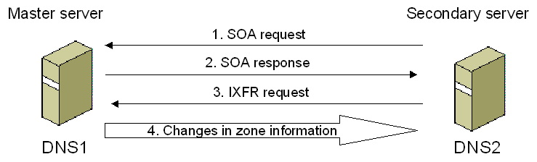
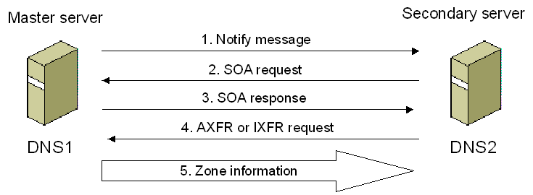
Transfer incremental (Incremental Zone Transfer)
Notificari
Protocoale de comunicaţie - Curs 8
Notes:
In an incremental zone transfer, the secondary server performs the same query for the SOA record of the master server and comparison of the Serial Number field. If changes exist, the secondary server sends an IXFR request (a request for an incremental zone transfer) to the master server. The master server sends the records that have changed, and the secondary server builds a new zone file from the records that have not changed and the records in the incremental zone transfer.
For the master server to determine the records that have changed, it must maintain a history database of changes made to its zone files. The zone file changes are linked to a serial number so that the master server can determine which changes were made to the zone past the serial number indicated in the IXFR request from the secondary server.
DNS Notify
For both full and incremental zone transfers, the secondary server always initiates the zone transfer based on periodically querying the master server for its SOA record. The original DNS RFCs do not define a notification mechanism if the master server wanted to immediately propagate a large number of changes to its secondary servers.
To improve the consistency of data among secondary servers, RFC 1996 specifies DNS Notify, an extension of DNS that allows master servers to send notifications to secondary servers that a zone transfer might be needed. Upon receipt of a DNS notification, secondary servers request the SOA record of their master server and initiate a full or incremental zone transfer as needed.
To determine the secondary servers to which notifications should be sent, the master server maintains a notify list (a list of IP addresses) for each zone. The master server sends notifications to only the servers in the notify list when the zone is updated.

Slide 27
Studiu individual
A. S. Tanenbaum Reţele de calculatoare, ed 4-a, BYBLOS 2003
7.1 DNS - SISTEMUL NUMELOR DE DOMENII
A. S. Tanenbaum Computer networks, 5-th ed. PEARSON 2011
7.1 DNS—THE DOMAIN NAME SYSTEM
Protocoale de comunicaţie - Curs 8

